Slide 1
Age and Gender Detection
Smitesh M Jadhav PGA - 14

Slide 2
TABLE OF CONTENTS
01
05
02
06
03
070
04
Introduction
Feature Extraction
Problem Statement
Model Building
Predict Test Data & Deployment
Pre Processings
07
Exploratory Data Analysis (EDA )
08
Conclusion & Scope

Slide 3
INTRODUCTION
﻿Facial analysis from images has gained a lot of interest because it helps in several different problems like better ad targeting for customers, better content recommendation system, security surveillance, and other fields as well.
Age and gender are a very important part of facial attributes and identifying them are the very basic of facial analysis and a required step for such tasks.
Many companies are using these kinds of tools for different purposes making it easier for them to work with customers, cater to their needs better and create a great experience for them.

Slide 4
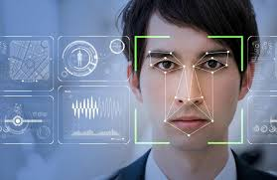
Problem Statement
﻿The project is focused on Gender and age detection where we are predicting gender and age of detected face from an input image or webcam using OpenCV (based on CNN model) and classifying them into gender category and predefined age range in python.

Slide 5
Dataset Description.
﻿
UTKFace dataset is a large-scale face dataset with long age span (range from 0 to 116 years old).
It has a total of 23708 images. The images cover large variations in facial expression, illumination, pose, resolution and occlusion.
We chose this dataset because of its relatively more uniform distributions, the diversity it has in image characteristics such as brightness, occlusion and position and also it involves images of the public data.
Each image is labeled with a 3-element tuple, with age (in years), gender (Male-0, Female-1) .
We used the same set of images for training, testing and validation, to have standardized results. This was done by dividing the data sets into train, test in 80: 20 ratios.

Slide 6
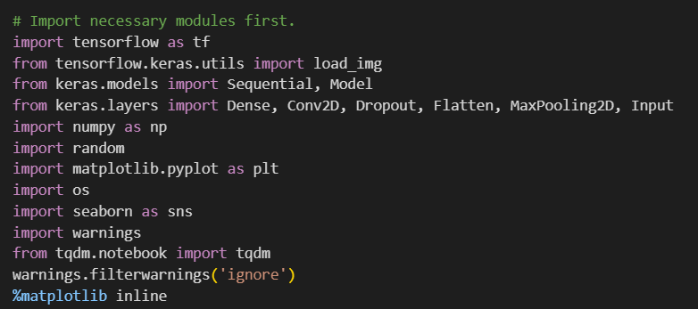
Importing All The Necessary Library

Slide 7

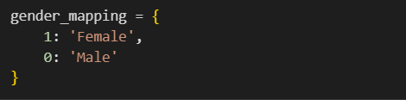
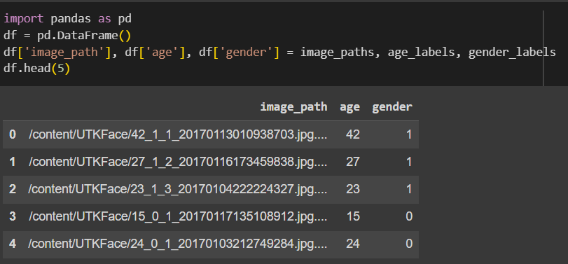
Pre Processings

Slide 8
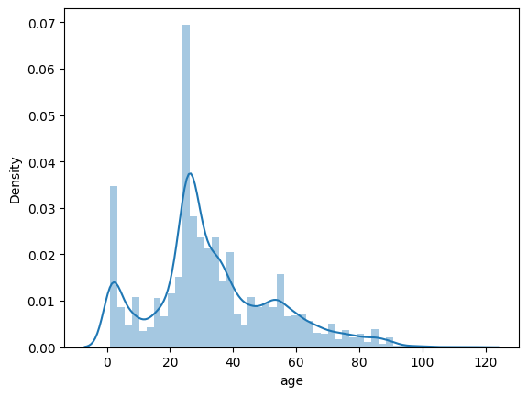
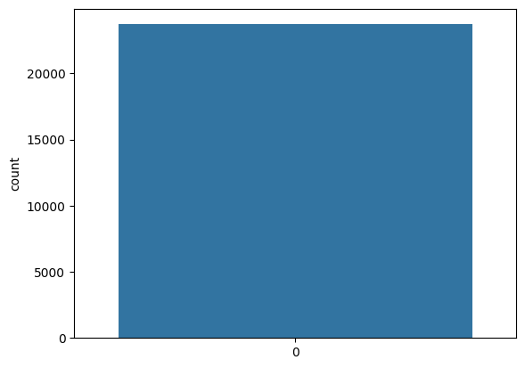
Exploratory Data Analysis (EDA)
The distribution roughly follows a normal distribution that is slightly skewed to the right with a median of around 27 years. The range is from 0 to 120 years. There are some outliers at the higher end of the distribution.
The number of samples for females are slightly higher than that of males. However, the dataset is not highly imbalanced.

Slide 9
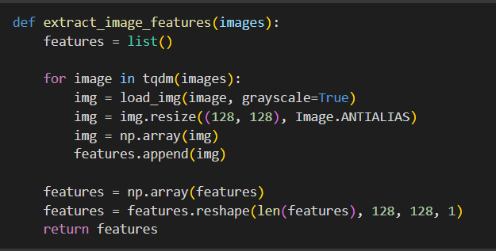
Feature Extraction.

Slide 10
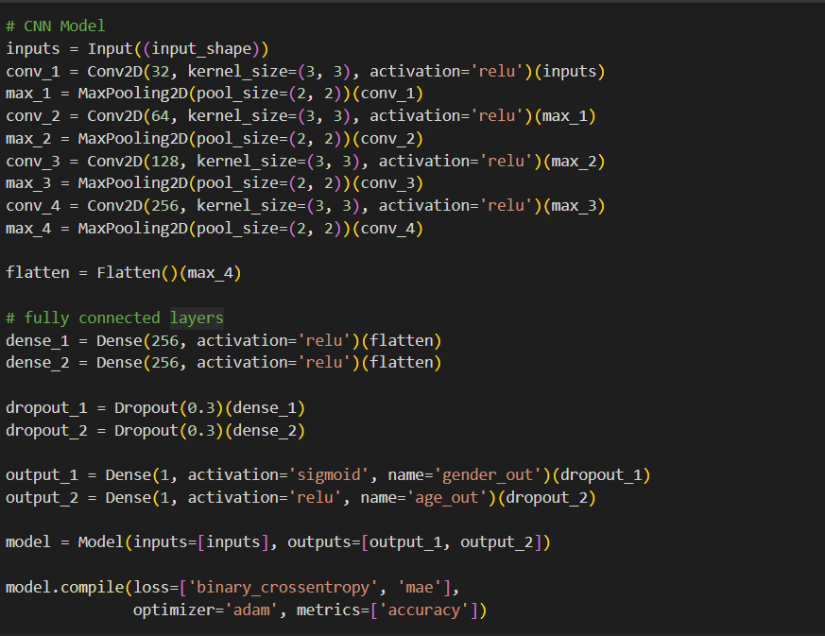
Model Building
Architecture: Utilized Conv2D layers for image data processing.
Layers: Constructed input, hidden, and output layers.
Hidden Layer: Applied ReLU activation function for positive range (0, Max).
Hidden Layer Enhancements: Incorporated max-pooling and same-padding.
Output Layer: For Gender We Used sigmoid activation & Relu From Age.

Slide 11
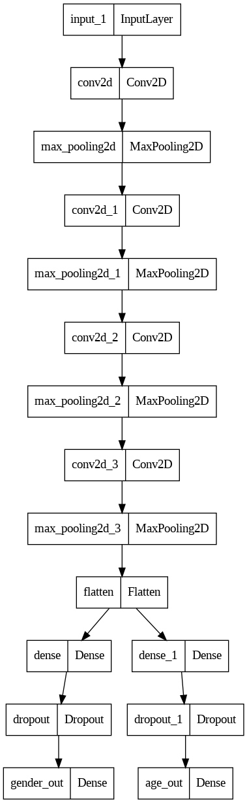
Plot the Model

Slide 12
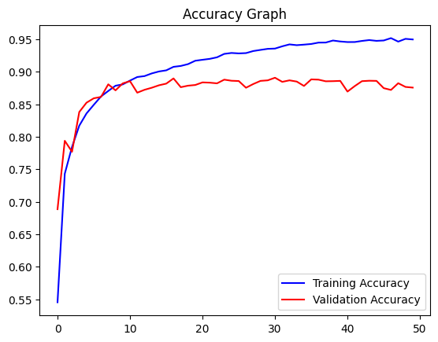
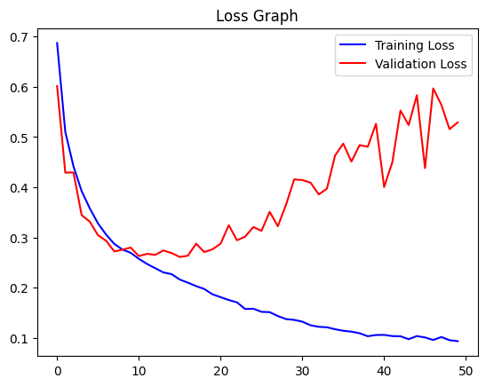
Training and Validation Plot

Slide 13
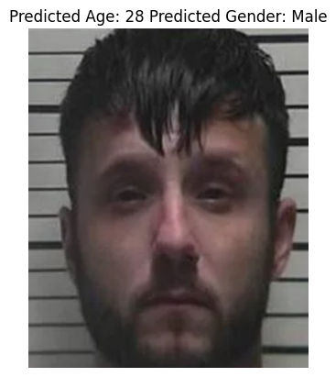
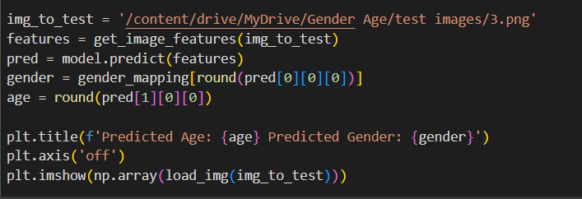
Testing Data and Deployment

Slide 14
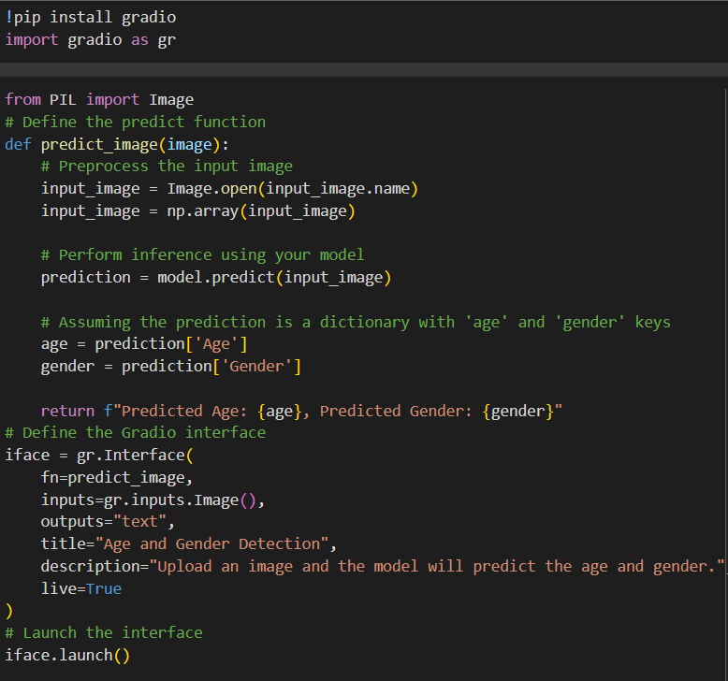
Deployment

Slide 15
Conclusion
﻿We have implemented a CNN to detect gender and age from a single picture of a face.
The performance of this system can be improved marginally by using more training data images. There is less availability of labeled images for age and gender, but CNN can still improve its performance.
As it is difficult to accurately guess an exact age from a single image because of factors like makeup, lighting, obstructions, and facial expressions.

Slide 16
Future Scope
It can be used for Retails and Marketing for Customer Segmentation and marketing Strategies.
In Security and Surveillance for Real time to detect Unauthorised access, monitor Public spaces and Provide alert for unusual activity.
In Health Care Applications for patient management and activity.
In educational to provide insights into student engagement and help instructors customize teaching methods based on the demographics of the audience.
In emotion and sentiment analysis can provide a more comprehensive understanding of user behavior and reactions. This can be applied in various contexts, including market research and user experience optimization.

Slide 17


